Slide 1
Week 5b
COMPUTATIONAL MATHEMATICS

Slide 2
Reference
Kisualaas, Jann. (2013). Numerical Methods in Engineering with Python 3. Cambridge University Press.
Johansson, Robert. (2015). Chapter 5. Equation Solving. Numerical Python: A Practical Techniques Approach for Industry, Apress.
Chapra, S. C., and Raymond P. Canale. (2010). Numerical methods for engineers, Sixth edition, McGraw Hill.
Kaw, A. (n.d.). Numerical Methods. Retrieved March 20, 2020, from https://nm.mathforcollege.com/

Slide 3
Two sources of numerical error
Round off error
Truncation error

Slide 4
Round off Error
Caused by representing a number approximately

Slide 5
Problems created by round off error
28 Americans were killed on February 25, 1991 by an Iraqi Scud missile in Dhahran, Saudi Arabia.
The patriot defense system failed to track and intercept the Scud. Why?

Slide 6
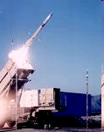
Problem with Patriot missile
Clock cycle of 1/10 seconds was represented in 24-bit fixed point register created an error of 9.5 x 10⁻⁸ seconds.
The battery was on for 100 consecutive hours, thus causing an inaccuracy of

Slide 7
Problem (cont.)
The shift calculated in the ranging system of the missile was 687 meters.
The target was considered to be out of range at a distance greater than 137 meters.

Slide 8
Effect of Carrying Significant Digits in Calculations

Slide 9
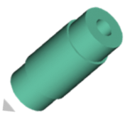
Find the contraction in the diameter
T_{a}=80ºF; T_{c}=-108ºF; D=12.363”
α = a₀+ a₁T + a₂T²

Slide 10
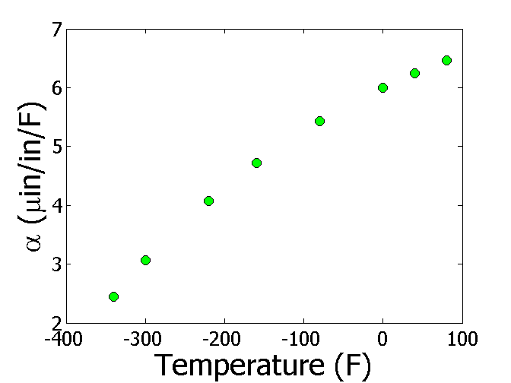
Thermal Expansion Coefficient vs Temperature
T(ºF) | α (μin/in/ºF)
-340 | 2.45
-300 | 3.07
-220 | 4.08
-160 | 4.72
-80 | 5.43
0 | 6.00
40 | 6.24
80 | 6.47

Slide 11
Regressing Data in Excel (general format)
α = -1E-05T² + 0.0062T + 6.0234

Slide 12
Observed and Predicted Values
α = -1E-05T² + 0.0062T + 6.0234
T(ºF) | α (μin/in/ºF) Given | α (μin/in/ºF) Predicted
-340 | 2.45 | 2.76
-300 | 3.07 | 3.26
-220 | 4.08 | 4.18
-160 | 4.72 | 4.78
-80 | 5.43 | 5.46
0 | 6.00 | 6.02
40 | 6.24 | 6.26
80 | 6.47 | 6.46

Slide 13
Regressing Data in Excel (scientific format)
α = -1.2360E-05T² + 6.2714E-03T + 6.0234

Slide 14
Observed and Predicted Values
α = -1.2360E-05T² + 6.2714E-03T + 6.0234
T(ºF) | α (μin/in/ºF) Given | α (μin/in/ºF) Predicted
-340 | 2.45 | 2.46
-300 | 3.07 | 3.03
-220 | 4.08 | 4.05
-160 | 4.72 | 4.70
-80 | 5.43 | 5.44
0 | 6.00 | 6.02
40 | 6.24 | 6.25
80 | 6.47 | 6.45

Slide 15
Observed and Predicted Values
α = -1.2360E-05T² + 6.2714E-03T + 6.0234
α = -1E-05T² + 0.0062T + 6.0234
T(ºF) | α (μin/in/ºF) Given | α (μin/in/ºF) Predicted | α (μin/in/ºF) Predicted
-340 | 2.45 | 2.46 | 2.76
-300 | 3.07 | 3.03 | 3.26
-220 | 4.08 | 4.05 | 4.18
-160 | 4.72 | 4.70 | 4.78
-80 | 5.43 | 5.44 | 5.46
0 | 6.00 | 6.02 | 6.02
40 | 6.24 | 6.25 | 6.26
80 | 6.47 | 6.45 | 6.46

Slide 16
Truncation error
Error caused by truncating or approximating a mathematical procedure.

Slide 17
Example of Truncation Error
Taking only a few terms of a Maclaurin series to
approximate
If only 3 terms are used,

Slide 18
Another Example of Truncation Error
Using a finite
to approximate
secant line
P
tangent line
Q
Figure 1. Approximate derivative using finite Δx

Slide 19
Another Example of Truncation Error
Using finite rectangles to approximate an integral.

Slide 20
Example 1 —Maclaurin series
Calculate the value of
with an absolute
relative approximate error of less than 1%.
n
1 | 1 | __ | ___
2 | 2.2 | 1.2 | 54.545
3 | 2.92 | 0.72 | 24.658
4 | 3.208 | 0.288 | 8.9776
5 | 3.2944 | 0.0864 | 2.6226
6 | 3.3151 | 0.020736 | 0.62550
6 terms are required. How many are required to get at least 1 significant digit correct in your answer?

Slide 21
Example 2 —Differentiation
Find
for
using
and
The actual value is
Truncation error is then,
Can you find the truncation error with

Slide 22
Example 3 — Integration
Use two rectangles of equal width to approximate the area under the curve for
over the interval

Slide 23
Integration example (cont.)
Choosing a width of 3, we have
Actual value is given by
Truncation error is then
Can you find the truncation error with 4 rectangles?

